Slide 1
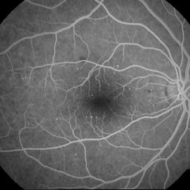
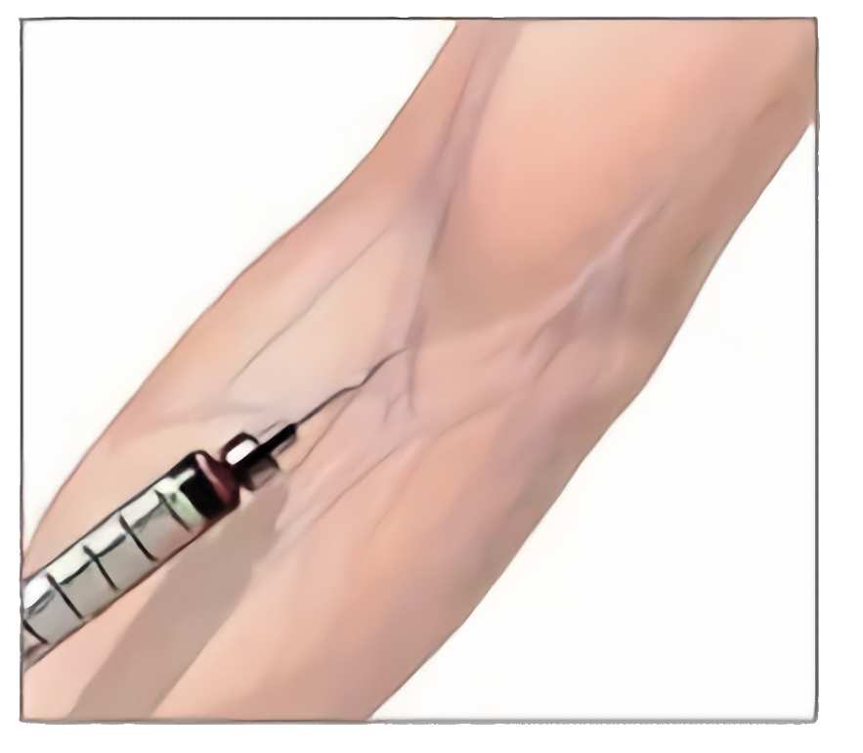
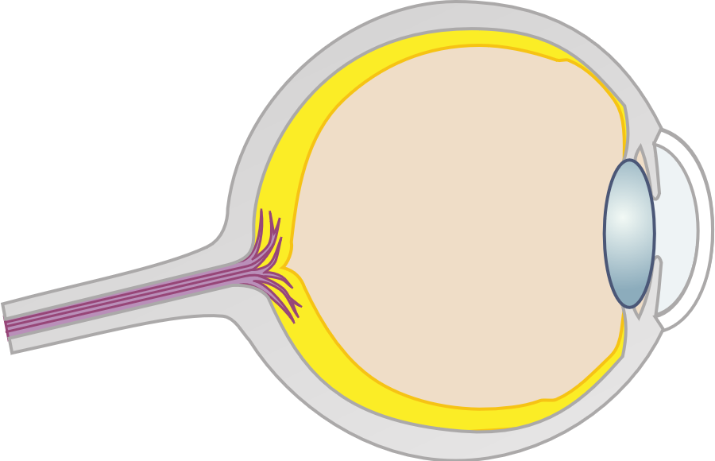
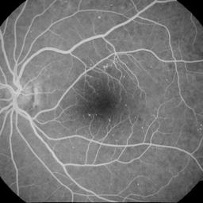
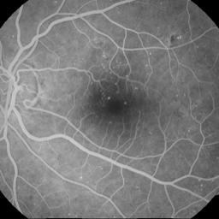





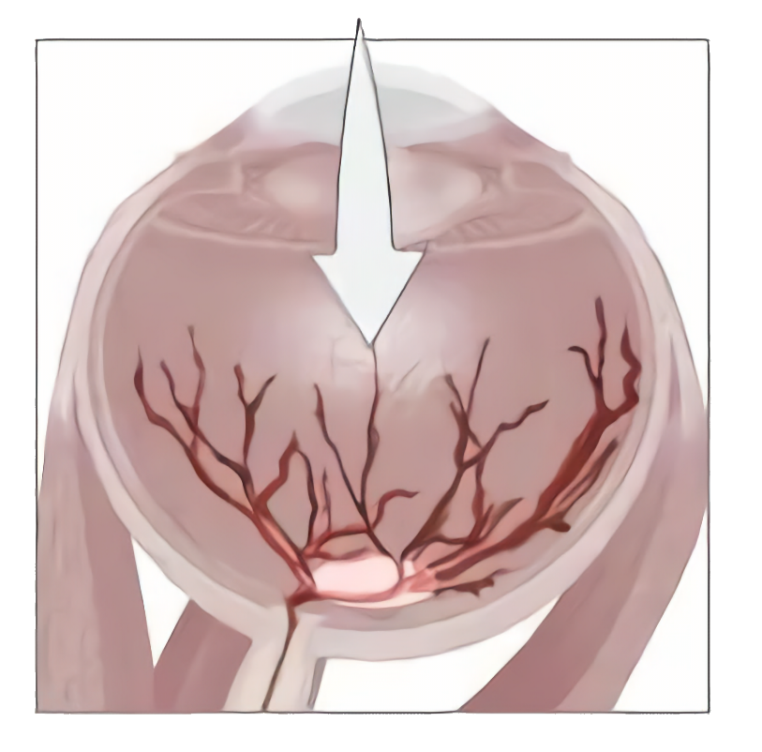
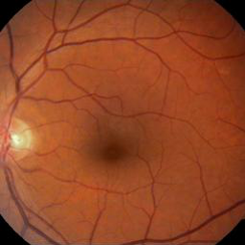

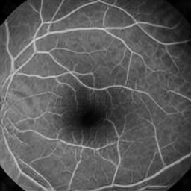

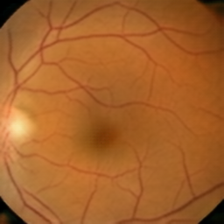
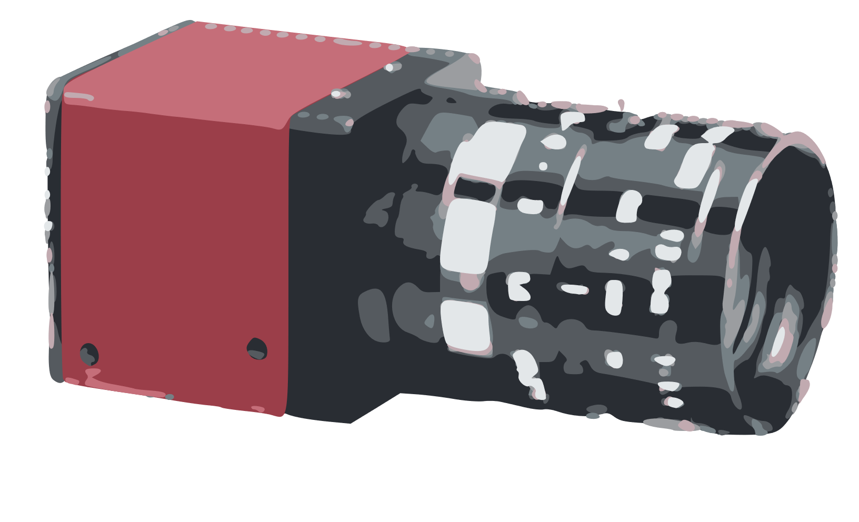
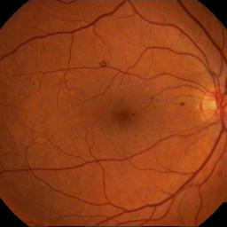
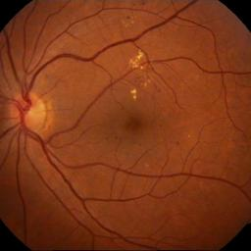
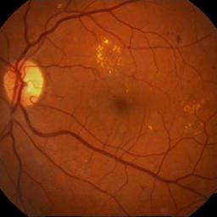


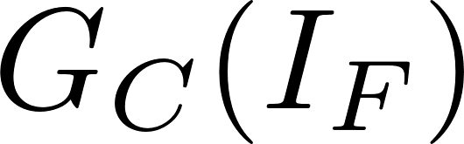
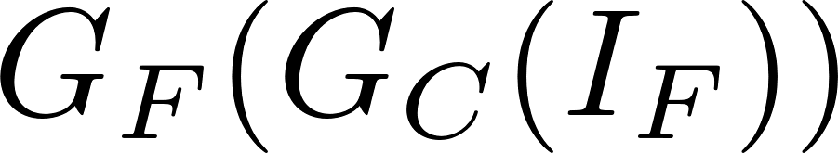
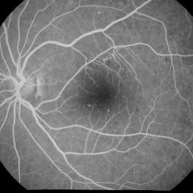
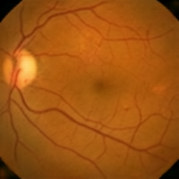
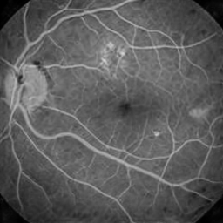

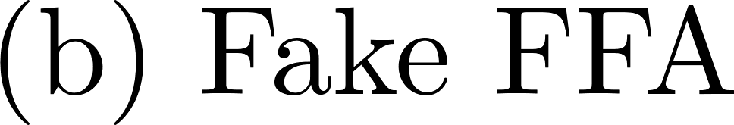

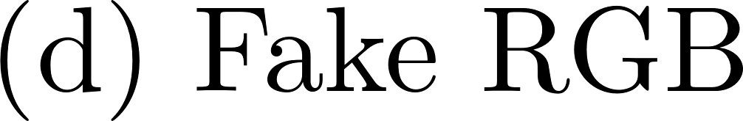
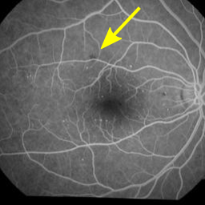
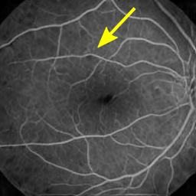
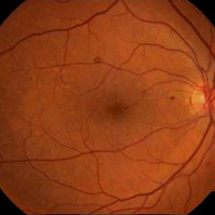
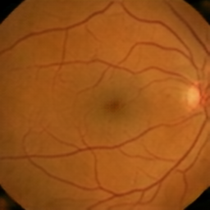
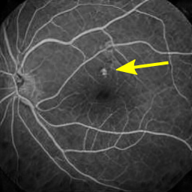
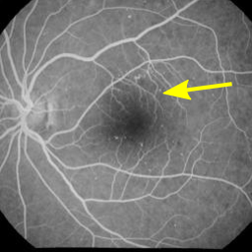
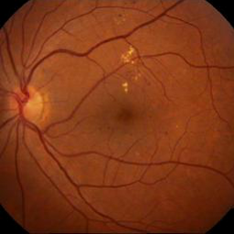
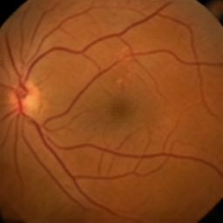
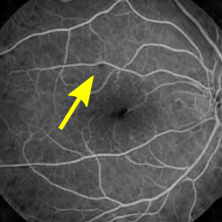
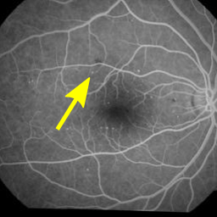
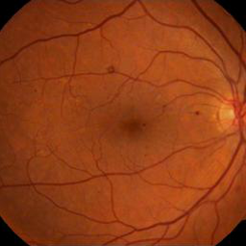
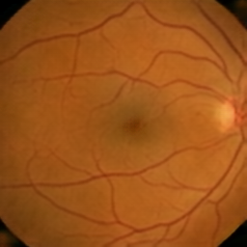
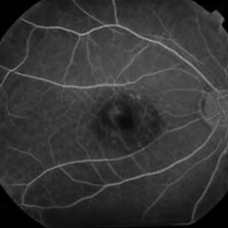
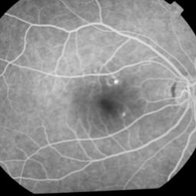
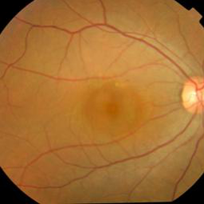
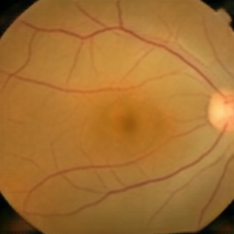
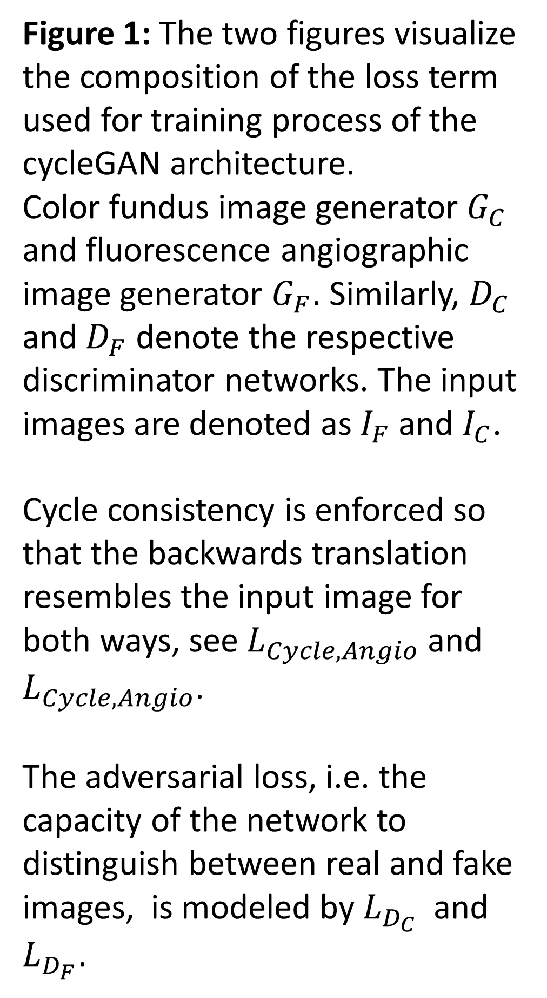
Synthetic Fundus Fluorescein Angiography using Deep Neural Networks
Florian Schiffers^{1,2}, Zekuan Yu¹, Steve Arguin¹, Andreas Maier², Qiushi Ren¹
¹ Department of Biomedical Engineering, College of Engineering, Peking University, Beijing, China ² Pattern Recognition Lab, Department of Computer Science, Friedrich-Alexander University Erlangen-Nuremberg, Erlangen, Germany
Angiographic Fundus Imaging
Figure 1: The two figures visualize the composition of the loss term used for training process of the cycleGAN architecture.
Color fundus image generator $G_{C}$ and fluorescence angiographic image generator $G_{F}$. Similarly, $D_{C}$ and $D_{F}$ denote the respective discriminator networks. The input images are denoted as $I_{F}$ and $I_{C}$.
Cycle consistency is enforced so that the backwards translation resembles the input image for both ways, see $L_{Cycle, Angio}$ and $L_{Cycle, Angio}$.
The adversarial loss, i.e. the capacity of the network to distinguish between real and fake images, is modeled by $L_{D_{C}}$ and $L_{D_{F}}$.
Excitation filter
Light Source
Blue light
White light
Fluorescein in retinal vessels
Fluorescent light
Reflected light
Barrier filter
Camera
Figure 1: An intravenous, fluorescent dye bounds to leukocytes, which excites the molecules when exposed to blue light. This, in turn, produces a narrow yellow-green light. The enhanced image highlights different features of the fundus.
Introduction
Angiographic imaging may pose risks of harm to the patient
Allergic reaction, nausea, thrombophlebitis, seizures
Materials and Methods
Generative adversarial networks (GAN) use a discriminator which discerns real and synthesized images.
CycleGAN translates images between two image domains A and B, without the need for tightly-coupled pairs
Dataset:
Training data: 365 color and 265 angiographic images
Test data: 14 color and 14 angiographic images
Images downsampled to resolution of 256 x 256
Results and Discussion
Computational Complexity: Negligible increase (2-D Fourier Transform vs. 1-D Fourier transform for FBP)
Substantial noise reduction possible for both CT and D-CT
Higher PSNR gain for CT compared to D-CT for optimal λ due to less spectral overlap of object and noise (+6.9dB vs +4.2dB)
Conventional CT: noise/resolution tradeoff (Fig. 2a)
Differential CT: noise/contrast tradeoff (Fig. 2b)
Planned: further experiments to investigate the effect on quantitation
Conclusions
Figure 2: Each row shows from left to right the real and generated angiographic image, the authentic color image and the reconstructed color image to show cycle consistency.
Noise suppressing filter for (differential) filtered backprojection
Linear method: low computational cost
Regularization independent of backprojection filter
References
[1] Raupach & Flohr: Analytical evaluation of the signal and noise propagation in x-ray differential phase-contrast computed tomography. Phys Med Biol. 2011 56(7)
[1] Raupach & Flohr: Analytical evaluation of the signal and noise propagation in x-ray differential phase-contrast computed tomography. Phys Med Biol. 2011 56(7)
[1] Raupach & Flohr: Analytical evaluation of the signal and noise propagation in x-ray differential phase-contrast computed tomography. Phys Med Biol. 2011 56(7)
[1] Raupach & Flohr: Analytical evaluation of the signal and noise propagation in x-ray differential phase-contrast computed tomography. Phys Med Biol. 2011 56(7)
Contact
 florian.schiffers@fau.de
☒ http://www5.bme-pekein ….
Pattern Recognition Lab, Department of Computer Science, Friedrich-Alexander University Erlangen-Nuremberg http://www5.cs.fau.de

